Slide 1
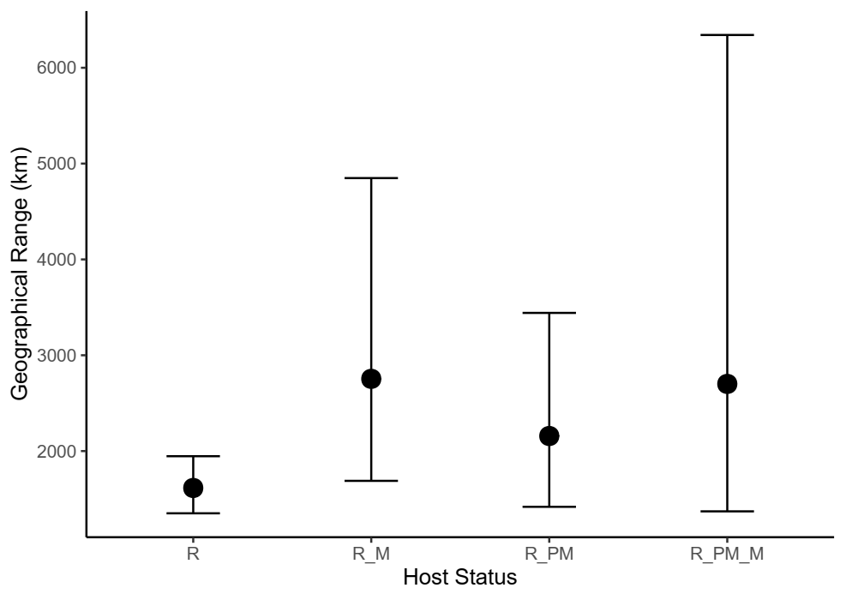
N= 9
N= 15
N= 22
N= 129

Slide 2
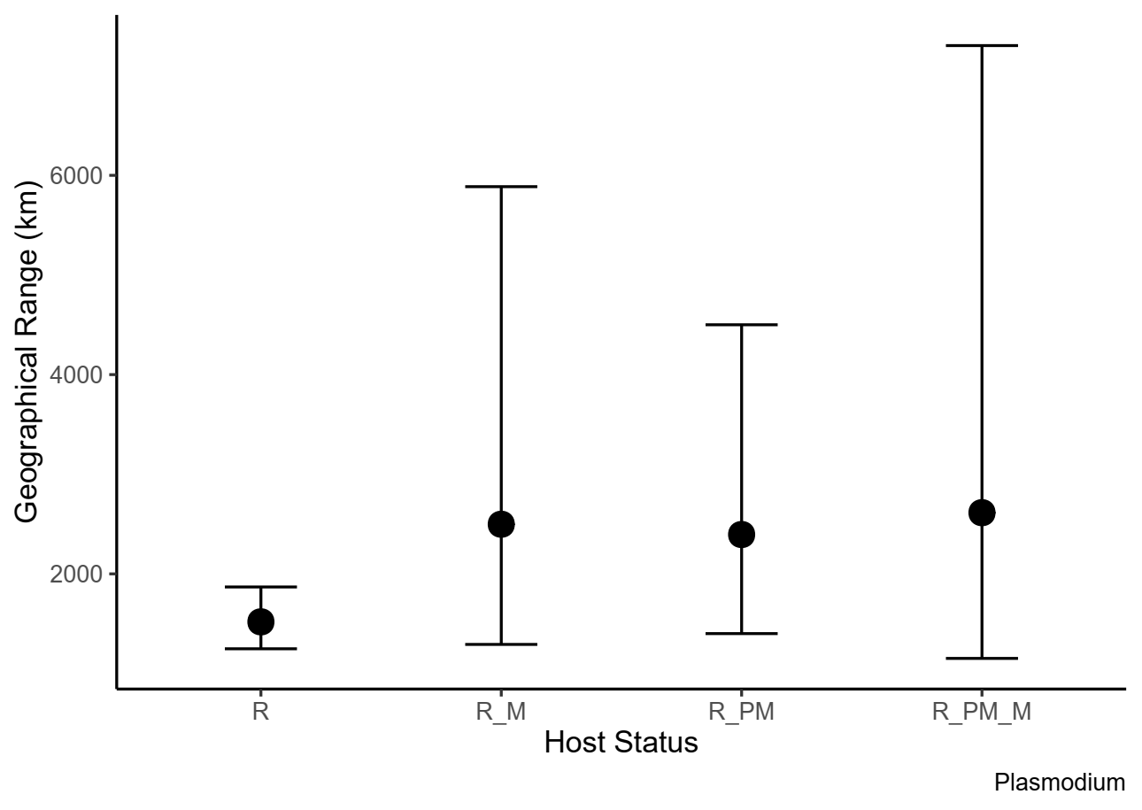
N= 6
N= 7
N= 12
N= 93

Slide 3
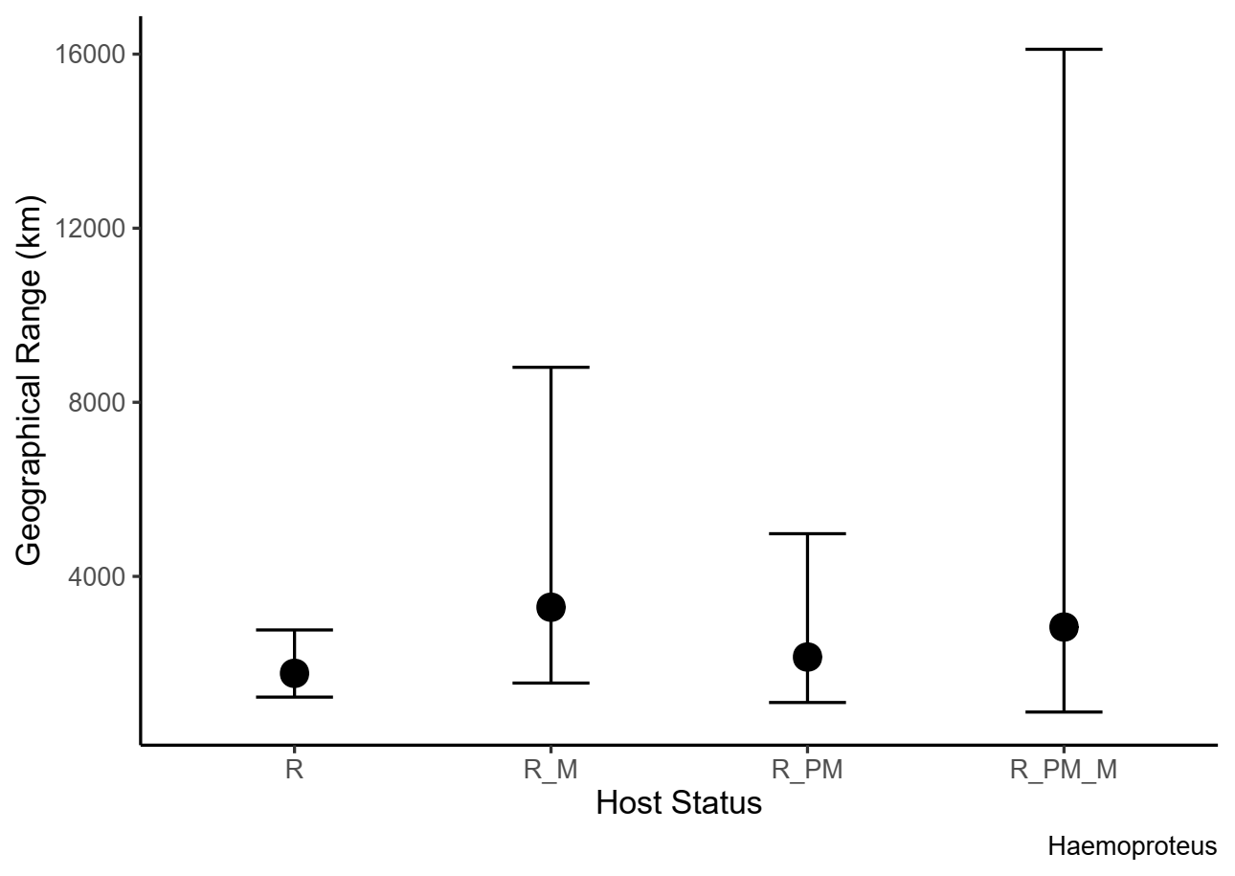
N= 3
N= 8
N= 10
N= 36

